Slide 1



Slide 2
Contents
1
Testing the Towers of Hanoi
2
Reviewing arrays
@acdit

Slide 3
Towers of Hanoi: A recursive algorithm
Call Stack
1 moveTower (disks, source, dest, spare)
2 If disk = 0
3 Move disk from source to dest
4 Else
5 moveTower (disk-1, source, spare, dest)
6 move disk from source to dest
7 moveTower (disk-1, spare, dest, source)
moveTower(3,Tower1,Tower3,Tower2)
Test this with 4 disks
@acdit

Slide 4
Some questions ….
How many recursive calls were made?
When is recursive call popped off the stack?
What happens to the program after a function call is popped?
Does it make a difference if the disks are even or odd?
What is the most number of calls that is on the call stack at one time?
How many recursive calls would you expect there to be made with 6 disks?
@acdit

Slide 5
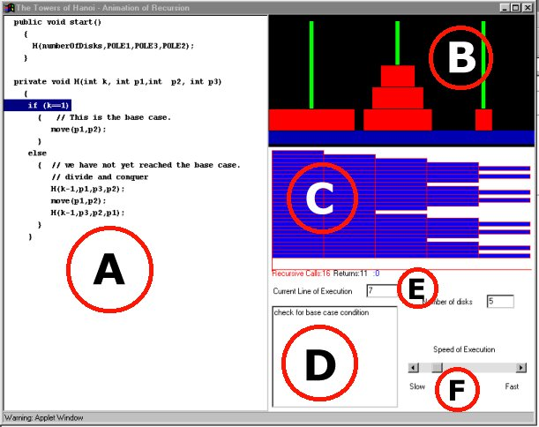
Monday’s Lab
Tower of Hanoi, Fibonacci problems
  Add main() which calls function
  Add printf’s
http://www.animatedrecursion.com/intermediate/towersofhanoi.html
@acdit

Slide 6
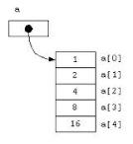
Recapping on arrays
What is an array?
@acdit

Slide 7
Recapping on arrays
An array is a finite, ordered set of homogeneous elements.
@acdit

Slide 8
Recapping on arrays
An array is a finite, ordered set of homogeneous elements.
Finite: there is a specific number of elements in the array
@acdit

Slide 9
Recapping on arrays
An array is a finite, ordered set of homogeneous elements.
Ordered: elements of the array are arranged so that there is a zeroth, first, second ..
@acdit

Slide 10
Recapping on arrays
An array is a finite, ordered set of homogeneous elements.
Homogeneous: all elements in the array must be of the same type
@acdit

Slide 11
Searching using Arrays
Write the iterative algorithm for finding a number in an ordered list.
Write the recursive algorithm for finding a number in an ordered list.
Illustrate the call stack using [0, 1, 2, 3, 4, 5, 6, 7, 8, 9, 10, 11], where the number that is being searched for is 3.
@acdit

Slide 12
Sorting & Searching
Write down 3 scenarios where you use searching.
Write down 3 scenarios where you use sorting.
@acdit

Slide 13
Finally….
Write out the Towers of Hanoi algorithm
@acdit

Slide 14
Thank You !

